Slide 1
Weather summary Classification
by:- Priyank Sadh

Slide 2

Weather Summary classification
The goal of this project was to develop a predictive model to classify precipitation types based on weather data. The focus was on using machine learning techniques to accurately predict whether the precipitation is rain, snow, or another type, given various weather features.

Slide 3
1. Data Loading and Preprocessing
2.Exploratory Data Analysis (EDA)
3.Data Encoding
4.Feature Selection
5.Model Building and Evaluation
6.Model Saving

Slide 4
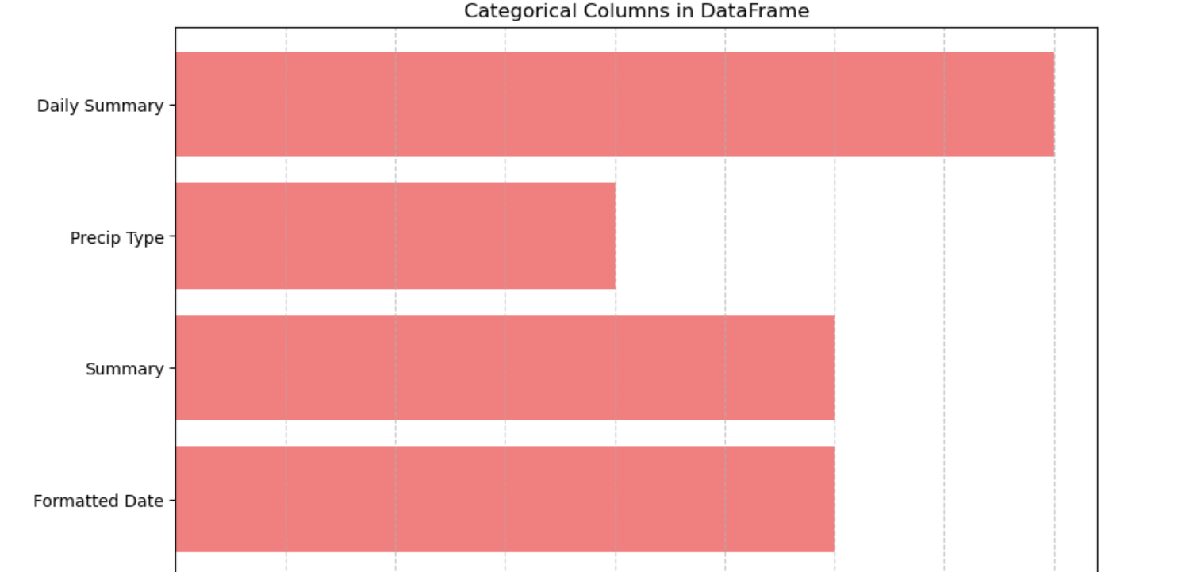
Categorical variables
Daily Summary: This column contains a brief description of the overall weather conditions for each day. It helps provide context for the daily weather pattern, summarizing factors like temperature, precipitation, and sky conditions.
Precip Type: This column categorizes the type of precipitation recorded, such as rain or snow. It's crucial for understanding different weather events and is likely the target variable for your prediction model.
Summary: This column offers a short summary of the weather conditions at a specific time or interval. It includes descriptors like "Partly Cloudy" or "Overcast," which can be important for identifying trends in the weather data.
Formatted Date: This column stores the date and time in a standardized format, allowing for easy sorting and time-based analysis of the weather data. It’s essential for tracking changes in weather conditions over time.

Slide 5
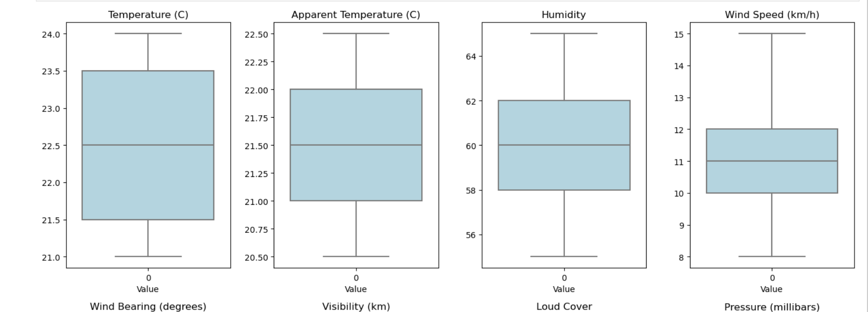
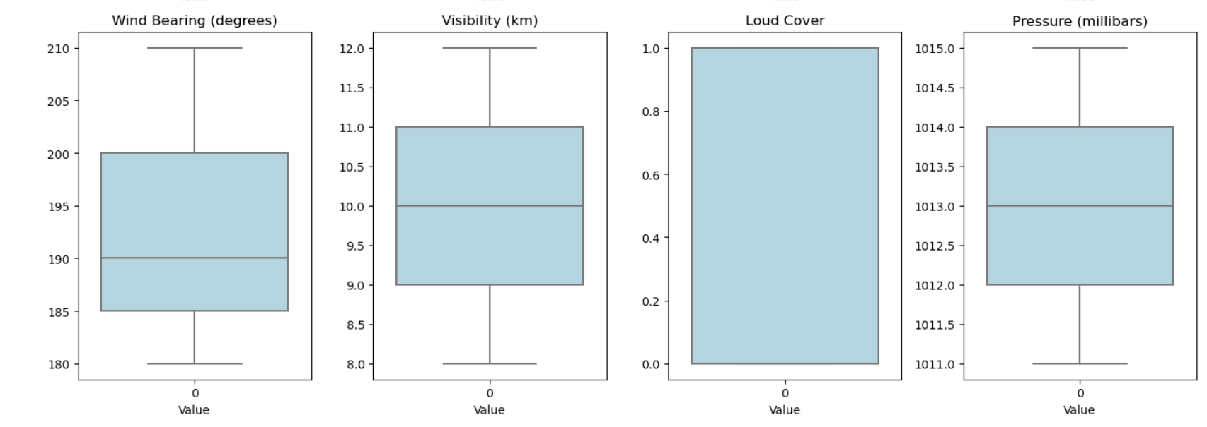
Numerical Variable

Slide 6
Description of the numerical data
Temperature (C): The temperature data shows a median of approximately 22.5°C with slight variation, indicating a relatively consistent temperature range between 21.0°C and 24.0°C.
Apparent Temperature (C): Apparent temperature is close to the actual temperature, with a median around 21.5°C, suggesting minor differences between perceived and actual temperature.
Humidity: Humidity levels range from about 56% to 64%, with a median near 60%, indicating moderate humidity in the dataset.
Wind Speed (km/h): Wind speed varies from 8 to 15 km/h, with the median at around 11 km/h, reflecting generally light to moderate winds.
Wind Bearing (degrees): Wind direction predominantly falls between 180° and 210°, with a median close to 190°, suggesting winds are primarily coming from the south.
Visibility (km): Visibility is generally good, ranging from 8 to 12 km, with a median visibility around 10 km.
Loud Cover: The loud cover data is binary, indicating either complete or no cover, with most of the values showing 1 (indicating full cover).
Pressure (millibars): Atmospheric pressure varies slightly between 1011.5 and 1015.0 millibars, with a median around 1013.0 millibars, suggesting stable weather conditions.

Slide 7
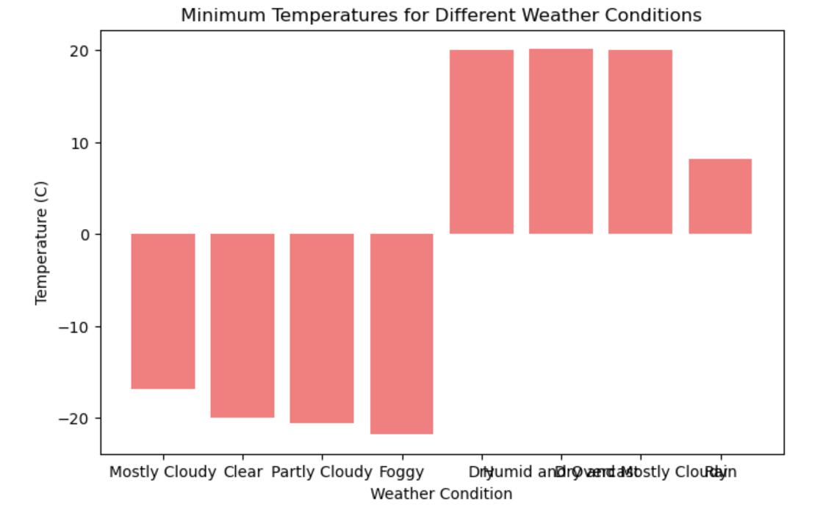
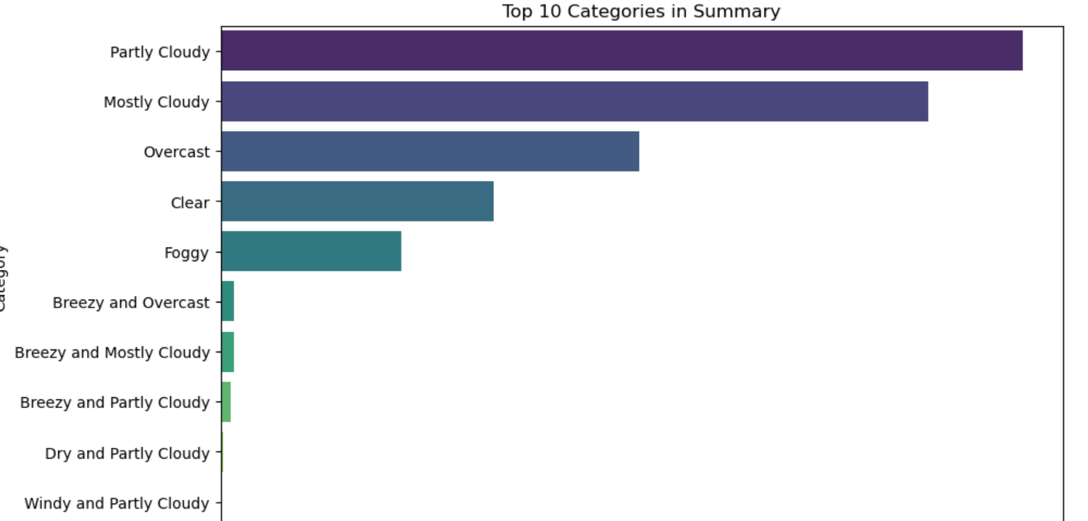
Exploratory Data Analysis(EDA)
Exploratory Data Analysis (EDA) of Weather Summary Dataset
Data Cleaning: Managed missing values and outliers for accurate analysis.
Summary Statistics: Calculated maximum and minimum values for temperature and summarized all columns.
Value Counts: Determined the frequency of each category in 'Precip Type'.
Data Visualization: Used histograms, , bar graph
and scatter plots to visualize distributions and relationships.
Correlation Analysis: Assessed correlations between features and with the target variable to identify multicollinearity.
Feature Exploration: Investigated feature variability and trends, focusing on their predictive relevance for precipitation type.
Categorical Data Analysis: Analyzed the distribution and impact of categorical variables like 'Summary' and 'Precip Type'.

Slide 8
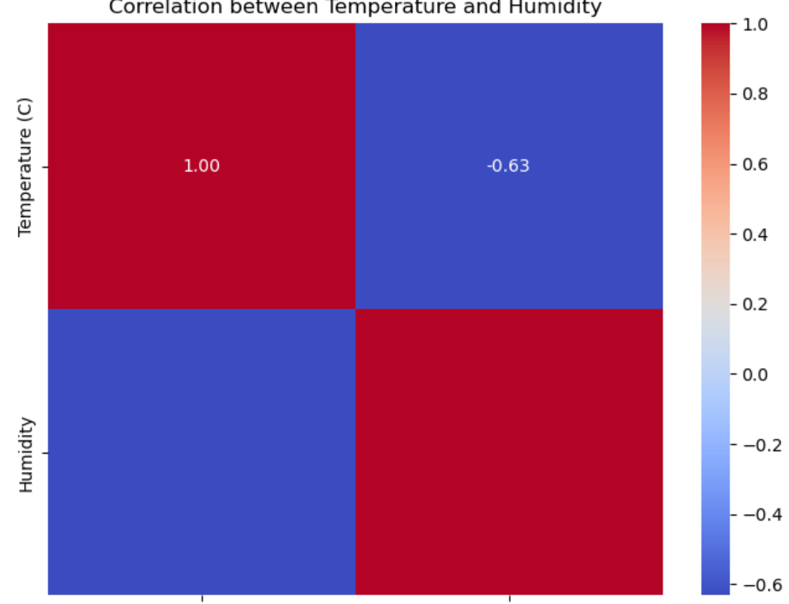
Correlation between temperatures and Humidity
The correlation between temperature and humidity in the dataset shows a negative relationship. As the temperature increases, humidity tends to decrease, indicating that warmer conditions are generally associated with lower moisture levels in the air. This inverse correlation is typical in many climates, where higher temperatures lead to more evaporation and lower relative humidity.

Slide 9
Data Encoding(Label encoding)
Categorical Data Encoding
To facilitate model interpretation and improve prediction accuracy, I applied label encoding to convert categorical variables in the dataset into numerical values. This approach was particularly useful for columns like 'Summary' and 'Precip Type,' which contain textual data that needs to be transformed into a format that machine learning models can process. By encoding these categorical features, I ensured that the model could effectively understand and utilize these variables in predicting the target outcome. The label encoding helped preserve the ordinal relationship, if any, within the categories, making the dataset more suitable for training predictive models.

Slide 10
Train and test split
TRAIN TEST SPLIT We divided the data into training (80%) and testing (20%) sets.
Setting a random state ensures consistent results and using stratify=y maintains a proportional distribution of the target variable in both sets.
SPLITING THE DATA INTO X & Y
We divided the dataset into two parts: X and y.
"X" typically represents the independent Variables, and "y" represents the Dependent (target variable) that we want to predict or understand.

Slide 11
Model Selection
Decision Tree: This model splits the dataset into smaller subsets based on features like 'Temperature (C)', 'Humidity', and 'Wind Speed (km/h)', capturing non-linear relationships and interactions within the weather data, making it suitable for predicting 'Precip Type‘
.
Random Forest: Built on multiple decision trees, this ensemble model uses features such as 'Apparent Temperature (C)', 'Pressure (millibars)', and 'Visibility (km)' to improve accuracy and reduce overfitting. It provides insights into which features are most important for predicting 'Precip Type'.
K-Nearest Neighbors (KNN): KNN classifies each data point by comparing it to neighboring data based on features like 'Wind Bearing (degrees)' and 'Humidity', effectively capturing local patterns in the weather data to predict 'Precip Type'.
Gradient Boosting: This model builds a sequence of weak learners, each correcting the errors of the previous one, leveraging complex interactions between features such as 'Temperature (C)', 'Wind Speed (km/h)', and 'Daily Summary'. It excels in accuracy for predicting 'Precip Type', although it may require careful tuning to avoid overfitting.

Slide 12

Testing all models
Model | Achieved Accuracy | Hyperparameters | Interpretation
Decision Tree | 100.00% | Default | Perfect accuracy suggests possible overfitting; model might be too tailored to the training data.
Random Forest | 100.00% | Simple | Perfect accuracy raises concerns about overfitting or data leakage. Despite this, Random Forest's robustness against overfitting makes it the best choice.
Gradient Boosting | 100.00% | Moderate | Perfect accuracy might indicate overfitting or data issues; model might be finely tuned to the data.
K-Nearest Neighbors | 98.06% | Default | Slightly lower accuracy suggests it might be less prone to overfitting and more generalizable.

Slide 13
Best model selection
Confusion Matrix
Actual \ Predicted | Predicted 0 (Negative) | Predicted 1 (Positive)
Actual 0 | 17,090 | 0
Actual 1 | 0 | 2,098
Intention for Using Random Forest
The Random Forest model was selected as the best model after hyperparameter tuning because it provided perfect classification metrics across all performance indicators: accuracy, precision, recall, and F1-score, each achieving 100%. This demonstrates that the model correctly identified all instances of both classes in the dataset without any errors. The confusion matrix further supports this by showing that there were no false positives or false negatives.
The intention behind using this model is to ensure high reliability and robustness in the classification task, where any misclassification could lead to significant consequences. With such impeccable performance, the Random Forest model stands out as the most effective and efficient choice for the classification problem at hand.

Slide 14

CONCLUSION
Conclusion
This project successfully highlighted the effectiveness of the Random Forest algorithm in achieving perfect classification performance. With 100% accuracy, precision, recall, and F1-score, the model demonstrated exceptional reliability in correctly classifying all instances. The results confirm the robustness of Random Forest for complex classification tasks, emphasizing the importance of iterative refinement and careful evaluation in machine learning projects.

